Slide 1
Results of EEA Supplier Survey
Compiled by Dianne Hill & Connor Smith

Slide 2
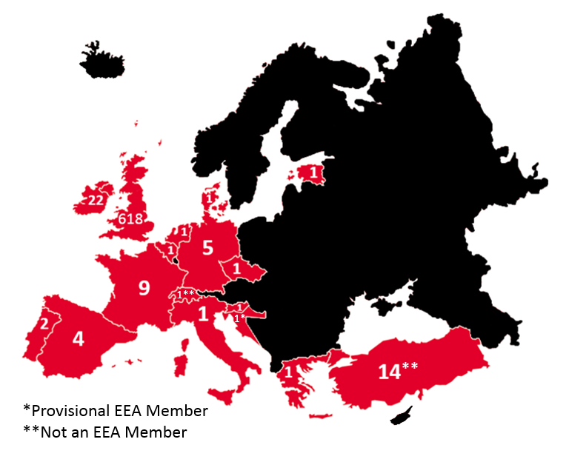
Our Current EEA Supply Chain
1
22
1
618
1
1
5
1
9
1*
1**
1
1*
1
1
2
1*
1
4
1
**
14

Slide 3
Rationale
Commercial organisations subject to the 2015 Modern Slavery Act must report annually on the steps that they have taken during the financial year to ensure that slavery and human trafficking are not taking place in their own business or in their supply chains.
As part of Visions 2016 Compliance Report as our international supply chain is governed by our Labour Standards Policy we aimed to map and look at our EEA supply chain for signs of modern slavery.
A survey was conducted with all parties who held a supplier relationship with Vison on or before 01.08.17.
The results of our survey would then aid in the formation of actions to be taken over proceeding years.
This would aid us in formulating an accurate risk assessment and channel our resources into ensuring that there were no occurrences in our supply chain of modern slavery.
3

Slide 4
Methodology
The questionnaire was designed using the best practice guidance and recommendations from the Chartered Institute of Procurement and Supply (CIPS)
A list of on going suppliers was obtained from our finance department
All suppliers were sent a questionnaire this included micro suppliers
Suppliers were sent the questionnaire and two reminders to return
4

Slide 5
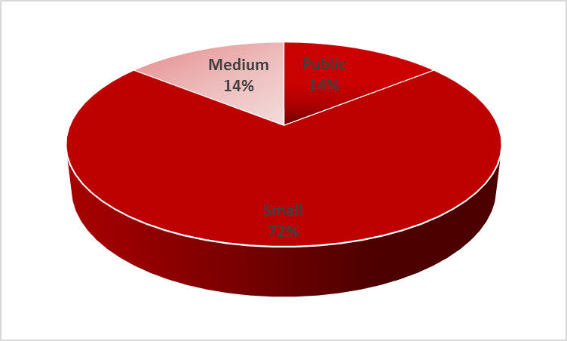
Results
Our Return rate was 87.1%
The breakdown failure to reply
Public Sector 14.29%
Private Sector 85.71%
Breakdown of company size who failed to return response
5

Slide 6
Results
Of the 87.1% respondent rate, 59.3% of companies had a formal documented programme and 62.5% of respondents used a 3rd party to risk asses their supply chain
Of all respondents 37.5% were not reviewing their supply chains for elements of modern slavery. All of these suppliers had no legal obligation to provide an annual compliance statement . What was not clear to them was that they would be asked by customers, legally required to provide a statement, of the steps they were taking. The Audit offices report into the impact of the Act supports our findings.
They Found:
Modern Slavery Strategy does not set out clear activities
Accountability for delivering the modern slavery strategy is unclear
Reporting Compliance is not monitored
The quality of data collected by the Home Office and NCA is variable, leading to an incomplete picture of the crime, the victims and the perpetrators. Without an accurate picture it is difficult to risk asses supply chains.
6

Slide 7
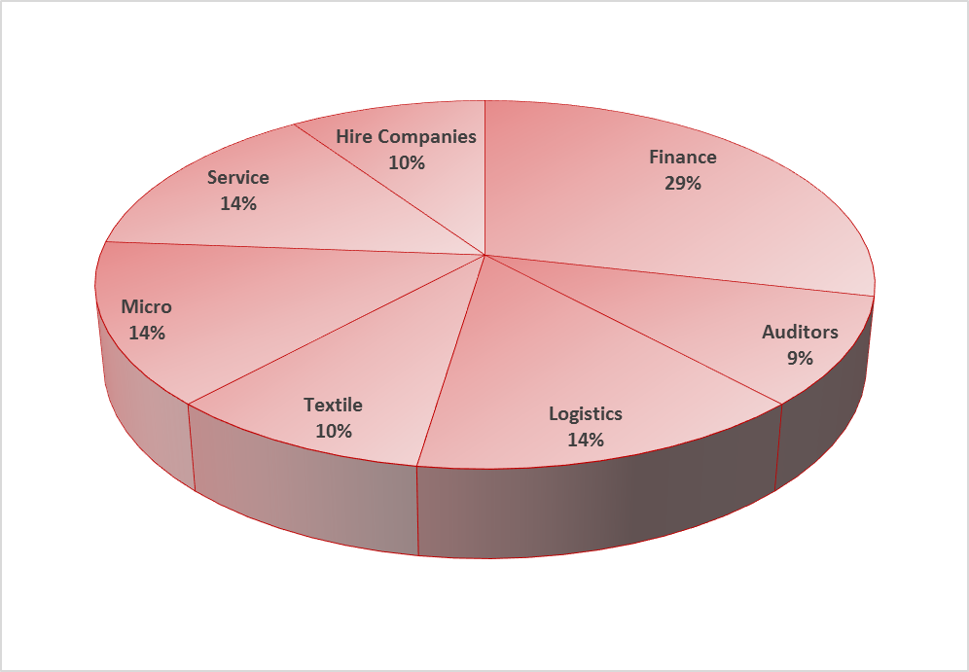
What this tells us about our supply Chain
We therefore need to look further into the 48% of our total supply chain who did not respond or were unaware of their obligations.
The following is a breakdown by sector
7

Slide 8
Risk assessment by Sector
Using a break down by sectors and likely hood indicators from The Salvation Army Report into Modern Slavery 2017 and Crime Figures for England and Wales 2017 (Office for National Statistics)
Sector | Probability in Sector | Probability in geographical | Overall Risk | Action
Finance | Low | Low | Low | Keep Under Review
Micro | High | Medium | High | Further analysis required
Service Industry | High | Medium | High | Further analysis required
Logistics | Medium | Medium | Medium | Keep Under Review
Textile | High | High | High | Further analysis required `
Hire Companies | Medium | Medium | Medium | Keep Under Review
Auditors | Low | Low | Low | Keep Under Review
8

Slide 9
Good Practice in our supply Chain
52% of all our suppliers have a formal process
Of these 62.5% have employed a third party specialist to asses their supply chain
93.8% ensure that they have written company standards that are communicated to their suppliers
93.8% ensure that all their staff have received formal training.
Where our suppliers are looking at monitoring their supply chain they are investing time and resources in the mitigating slavery and human trafficking .
9

